Slide 1
The Belgian association of surface finishing of
of materials
VOM defends the market and boosts your business

Slide 2
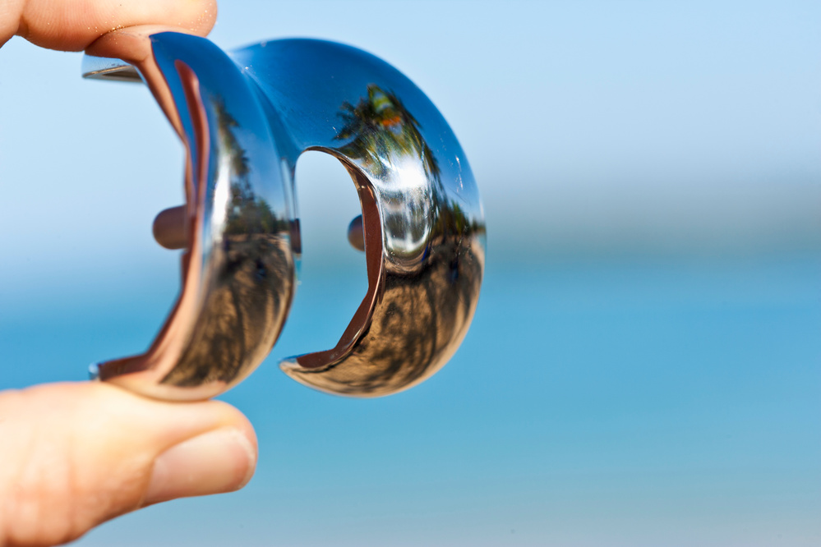
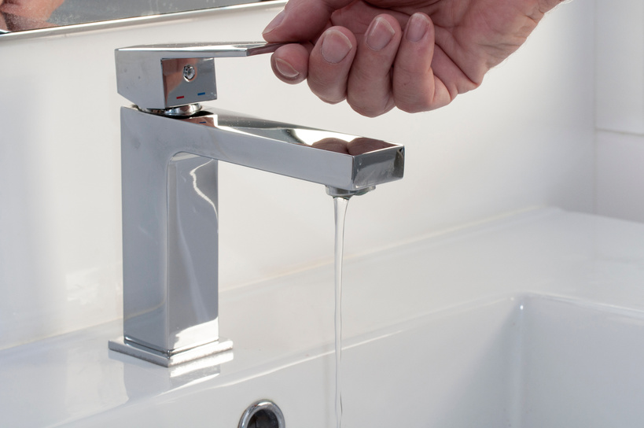
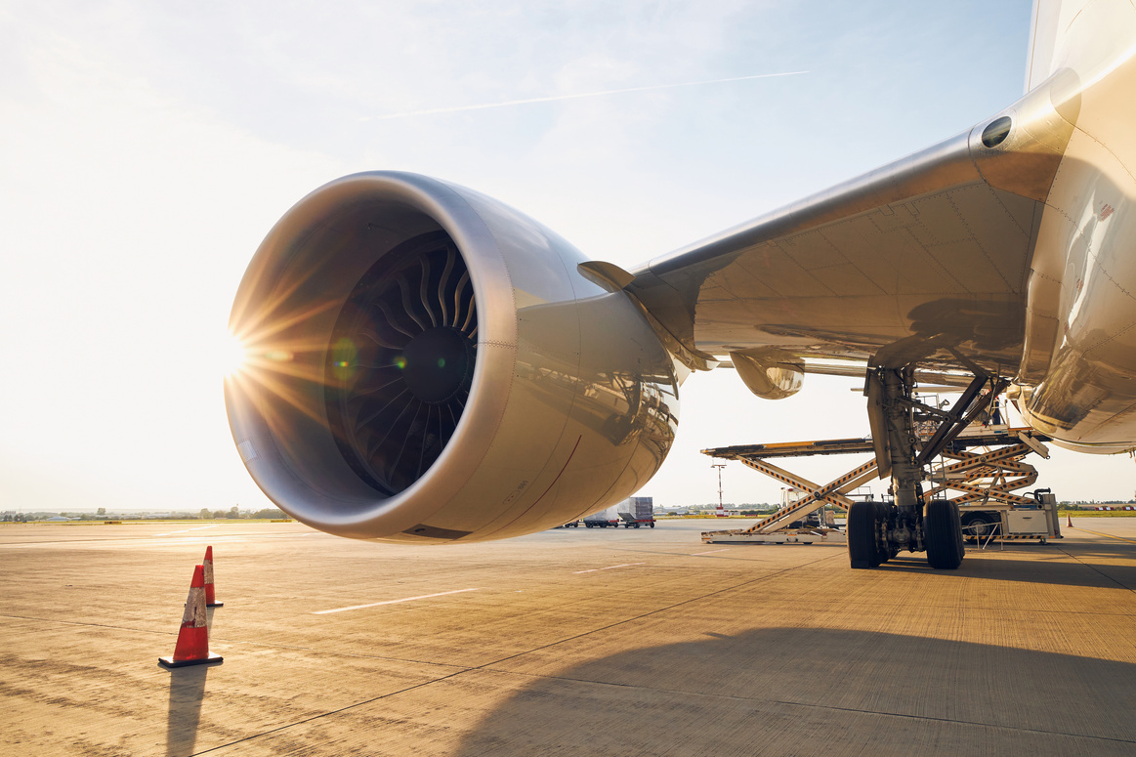
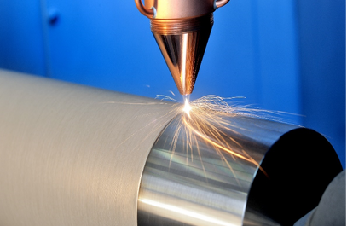
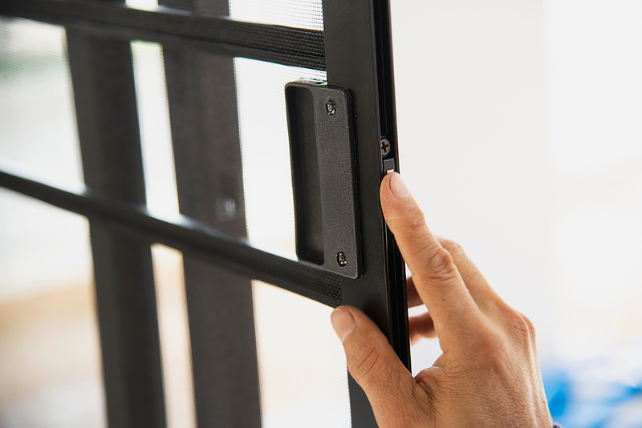
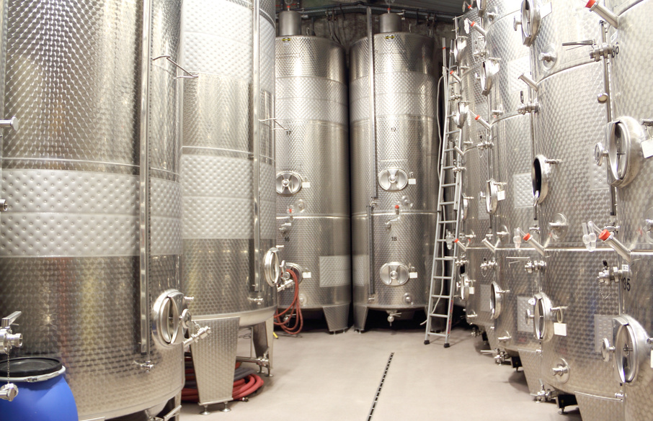
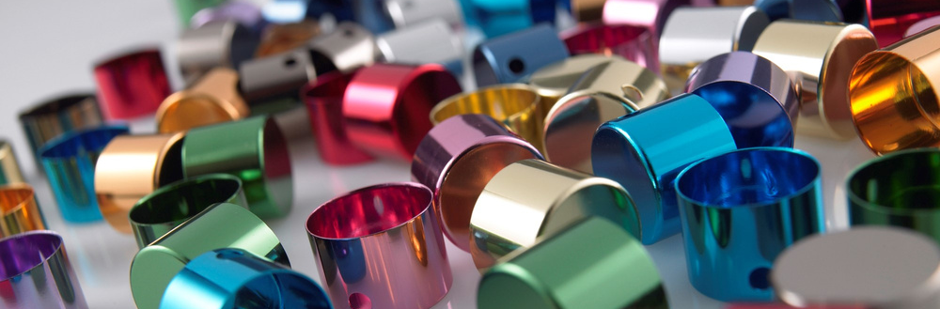
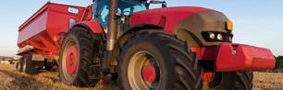
Surface finishing = omnipresent technology
Aeronautics
Agri-food
Architecture
Military
Automotive
Building
Foundry
Construction
Design
(micro)Electronics
Life sciences
Machinery
Medical
Metallurgy
Transportation
...

Slide 3
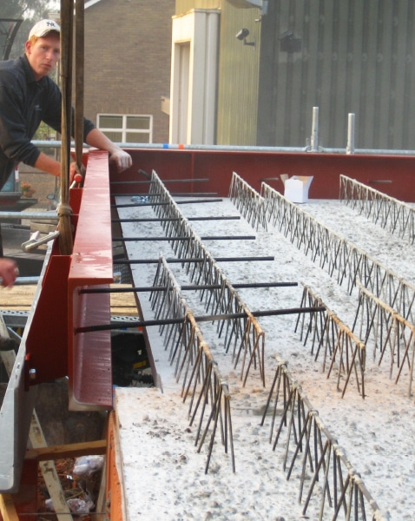
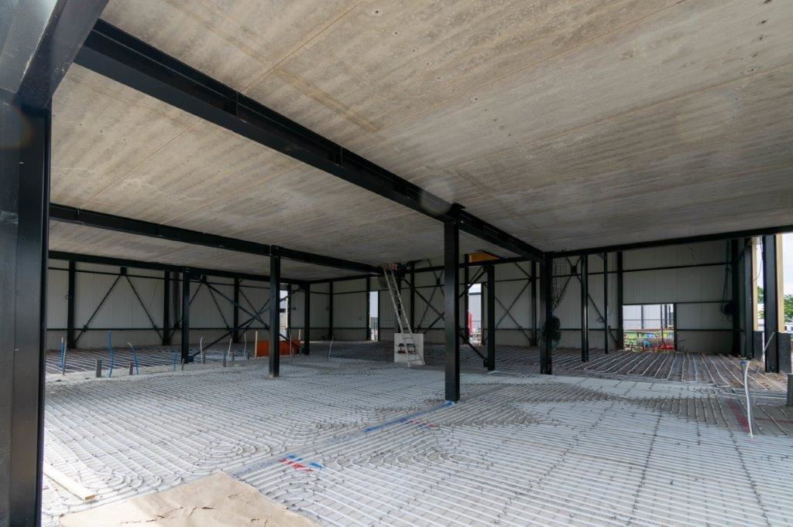
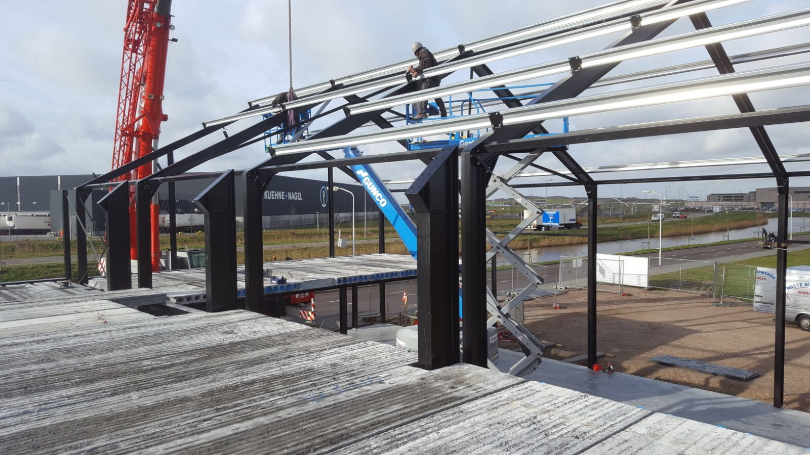
Some examples of Steel & Concrete

Slide 4
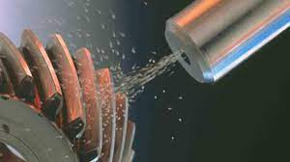
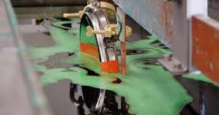
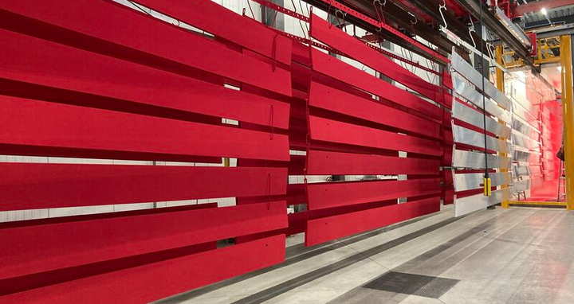
Quelques exemples de TECHNOLOGIES
Some examples of TECHNOLOGIES
Mechanical, chemical and electrochemical pretreatments
Metallic layers obtained by: -> electroplating
-> chemical process / electroless plating
-> thermal spraying / metallization
-> immersion in a molten metal bath
-> vacuum deposition
Organic coatings: liquid paints, powder coating
Enamelling
Thermal and thermochemical treatments

Slide 5
+/- 20,000 employees according to social security statistics
260 MEMBERS
NOS MEMBRES - CIBLE
Principals
6
Integrated companies
56
Subcontractors
99
Product suppliers
61
Equipment suppliers
54
Engineering
16
Expertise
7
Education
12
Service providers
57
0
25
50
75
100

Slide 6
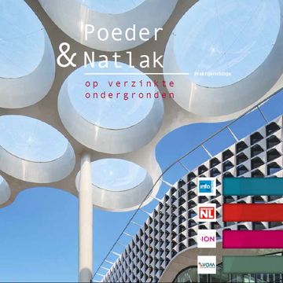
HOW DOES VOM SUPPORT THE SURFACE TREATMENT INDUSTRY?
NOS MEMBRES - CIBLE
COMMENT LA VOM SOUTIENT NOS INDUSTRIELS ?
Promotion of surface treatment technology
Transferring technical knowledge to companies
Spokesperson for the industry
Defending interests of the industry

Slide 7
Together, we can turn every challenge into an opportunity
CLEAN INDUSTRIAL DEAL
SUSTAINABLE PRODUCTION
ENERGY TRANSITION
EMPLOYEES
REGULATIONS

Slide 8
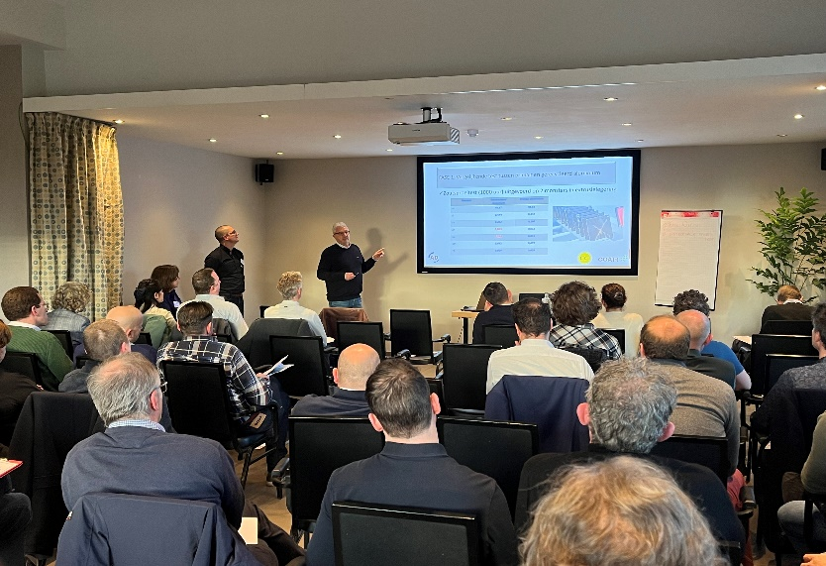
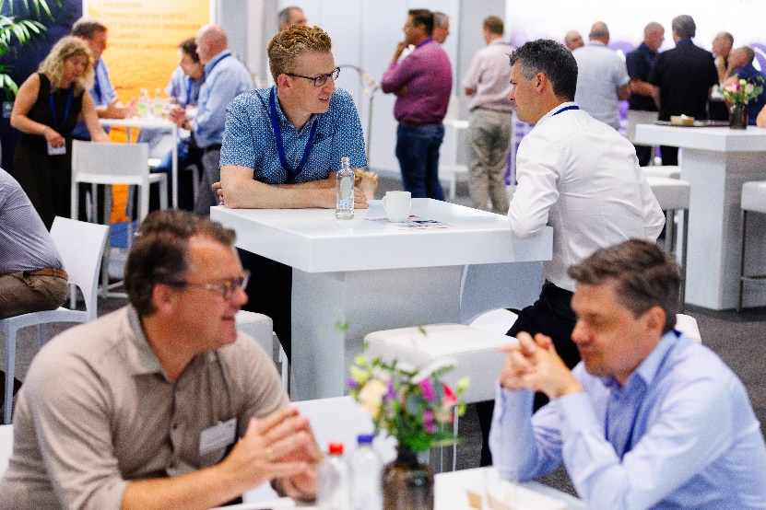
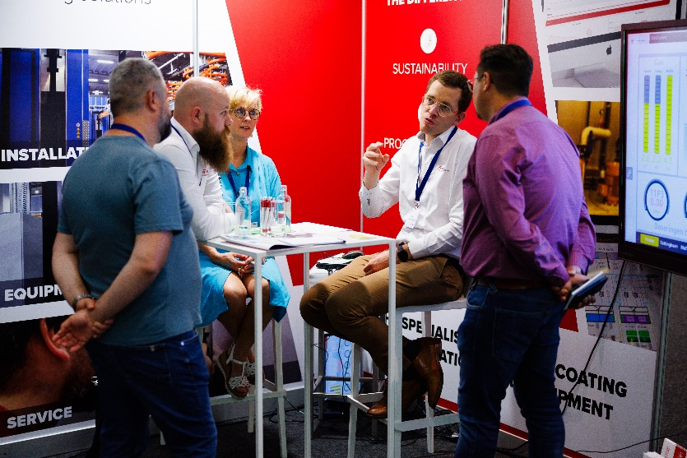
MEDIA
ACTIVITIES
Seminars
Training
Mise en réseau
Networking
E-VOMinfo 2X/month
Mailing
VOMinfo 6X/year
Fairs

Slide 9
PUBLICATIONS

Slide 10
2023
Notes:
Pitch Veerle
Wist je datje: wat hebben deze bedrijven met elkaar gemeen?
VOM = promotie van kwaliteitsvol ondernemen. QSC= vastgelegd door een onafhankelijke externe partij.
2024: Rebranding (nieuw logo & nieuwe website) & campagne voeren naar gebruikers/voorschrijvers
TO DO Michelle : zie slide van Sales PPT.

Slide 11
CERTIFICATION: VOM objectives
Promoting quality lacquering,
Distribute and publish information on the Belgian market,
Reviewing document content
www.qualisteelcoat.net
Certified lacquering companies www.vom.be

Slide 12
23/01 | SÉMINAIRE : système duplex et protection anticorrosion
28/01 | OPLEIDING: industriële schilderwerken & inspectie van staalstructuren
11/02 | OPLEIDING: chemische voorbehandeling
7/03 | BEDRIJFSBEZOEK bij DOVY - Roeselare
10/04 | FORMATION : Anodisation de l'aluminium - Secteur aéronautique
23/04 | VOM ON TOUR en Wallonie : Visite de AGC Glass Europe
29/04 | Algemene Vergadering / Assemblée Générale 2025 ONLINE
13/05 | YOUNG VOM goes to STOW
20/05 | OPLEIDING linkedin hands on workshop
5/06 | YOUNG VOM invites a guest speaker
19/06 | VOM ON TOUR in Vlaanderen: CNH Industrial
11/09 | YOUNG VOM meets experience
17/09 | VOM ON TOUR in vlaanderen: Reynaers campus Duffel
25/09 | PROMOSURF SEMINAR on non-destructive testing (NDT) in surface treatments
7/10 | OPLEIDING: corrosieverschijnselen & preventieve maatregelen
23/10 | YOUNG VOM goes to ALRO
19+20/11 | FUTURE SURFACES 2025, Benelux network event Congress & Exhibition Surface Treatment Industry: ready for 2030!
Programma
2025

Slide 15
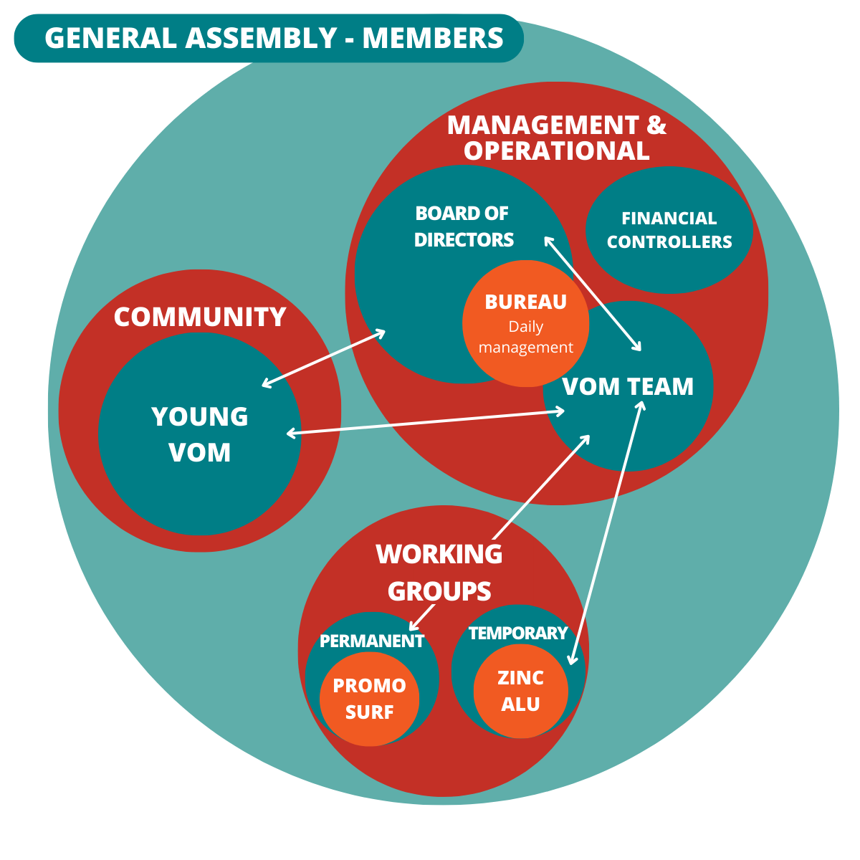
GOVERNANCE
ACTIVE INVOLVEMENT
of our members

Slide 16
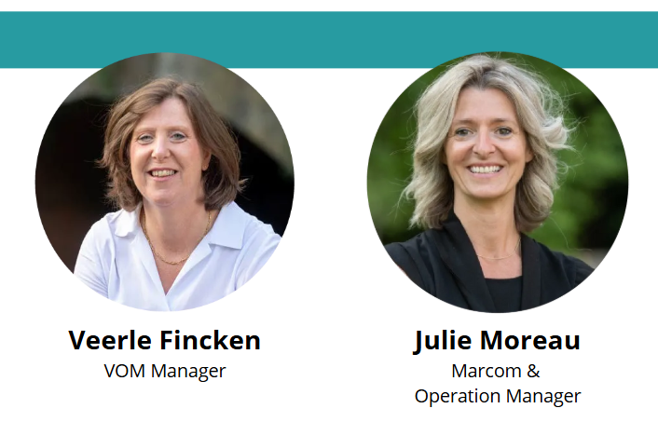
L'ÉQUIPE
VOM TEAM

Slide 17
BOARD OF VOM

Slide 18
WORKING GROUPS

Slide 19
COMMUNITY
Community of young people under 40 working in the surface treatment industry
Activities
Networking
Company visits

Slide 20
NOS PAENAIRES Européens
EUROPEAN PARTNERS
PARTNERS
NOS PARTENAIRES
Notes:
nos partenaires régionals

Slide 21
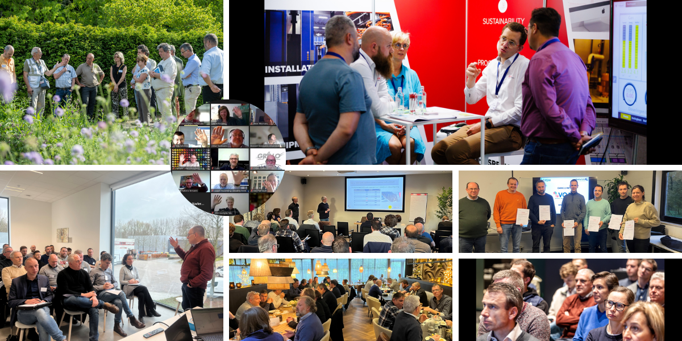
VOM IN THE PICTURE

Slide 22
VOM vzw
Kapeldreef 60
BE-3001 Leuven
www.vom.be
info@vom.be
+32 (0)16 401420

